Slide 1

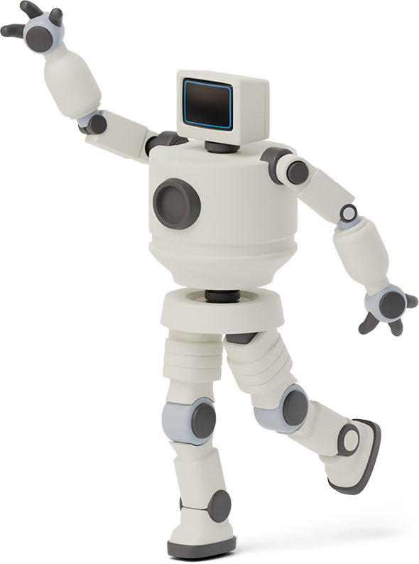

Hello!
I am CNXRETAIL
I am a software and I am here because I love to help SMEs grow

Slide 2

Top 3 SME headaches?
Poor Customer Retention Strategies
03
Bookkeeping
Cashflow, Delayed Recievables, Delayed Payables, Tracking Expenses.
01
02
Poor Customer Communication Strategies

Slide 3

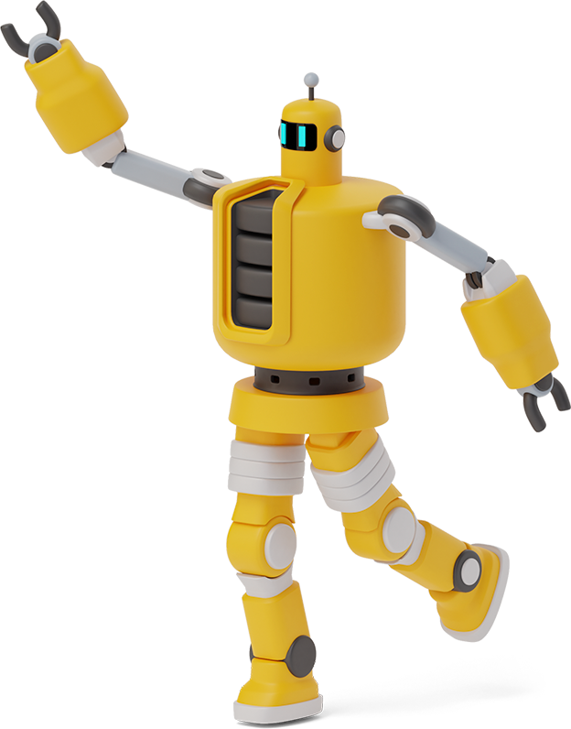
Do you know ? 7 IN 10 SMES FAIL
WHY?
Poor Record keeping
Use of traditional and manual method of communication with clients (social media messaging).

Slide 4



LIKE I SAID, I LOVE SMES, I WOULD HELP
Contact Management
Email Marketing
Reminders
Quotation
Bills and Payments
Invoicing and Receipts
Reports
Point of Sales
Cloud Storage/File Management

Slide 5
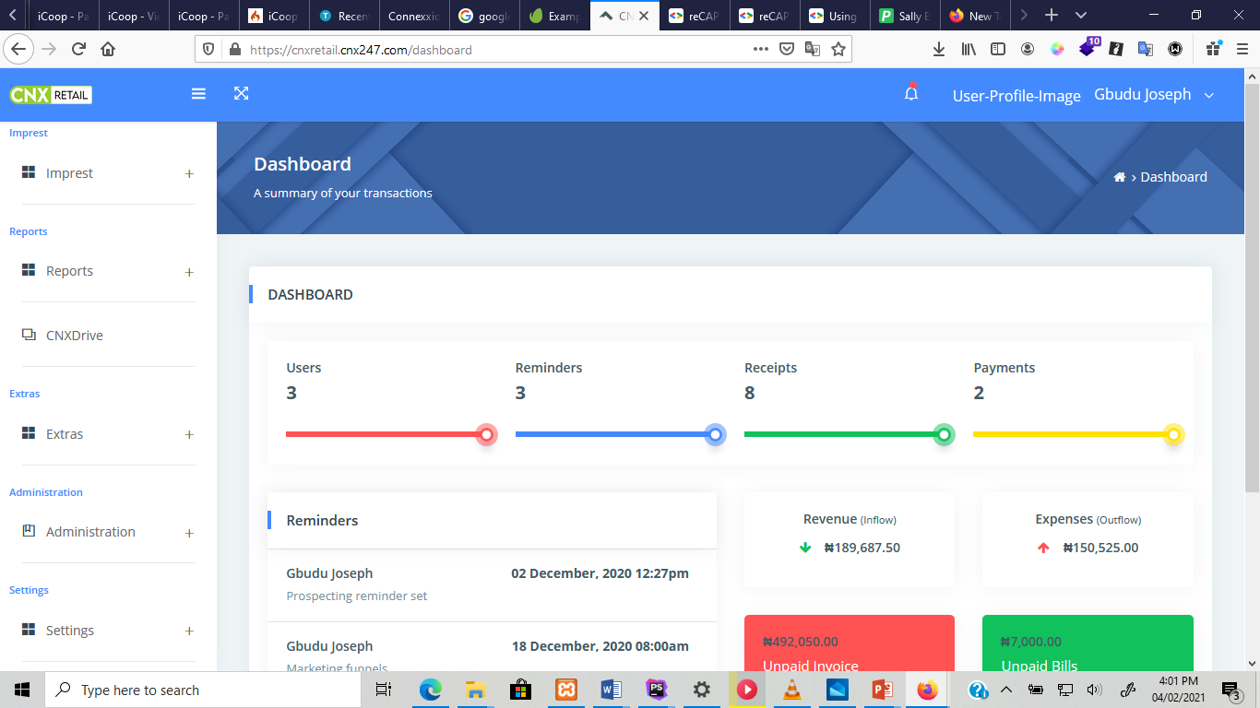


WHY USE ME?
I guarantee 99% customer retention strategies
You get rid of 80% of your paper work.
I am Nigerian made
I am secured
I vibe with the 21st century business model trend

Slide 6
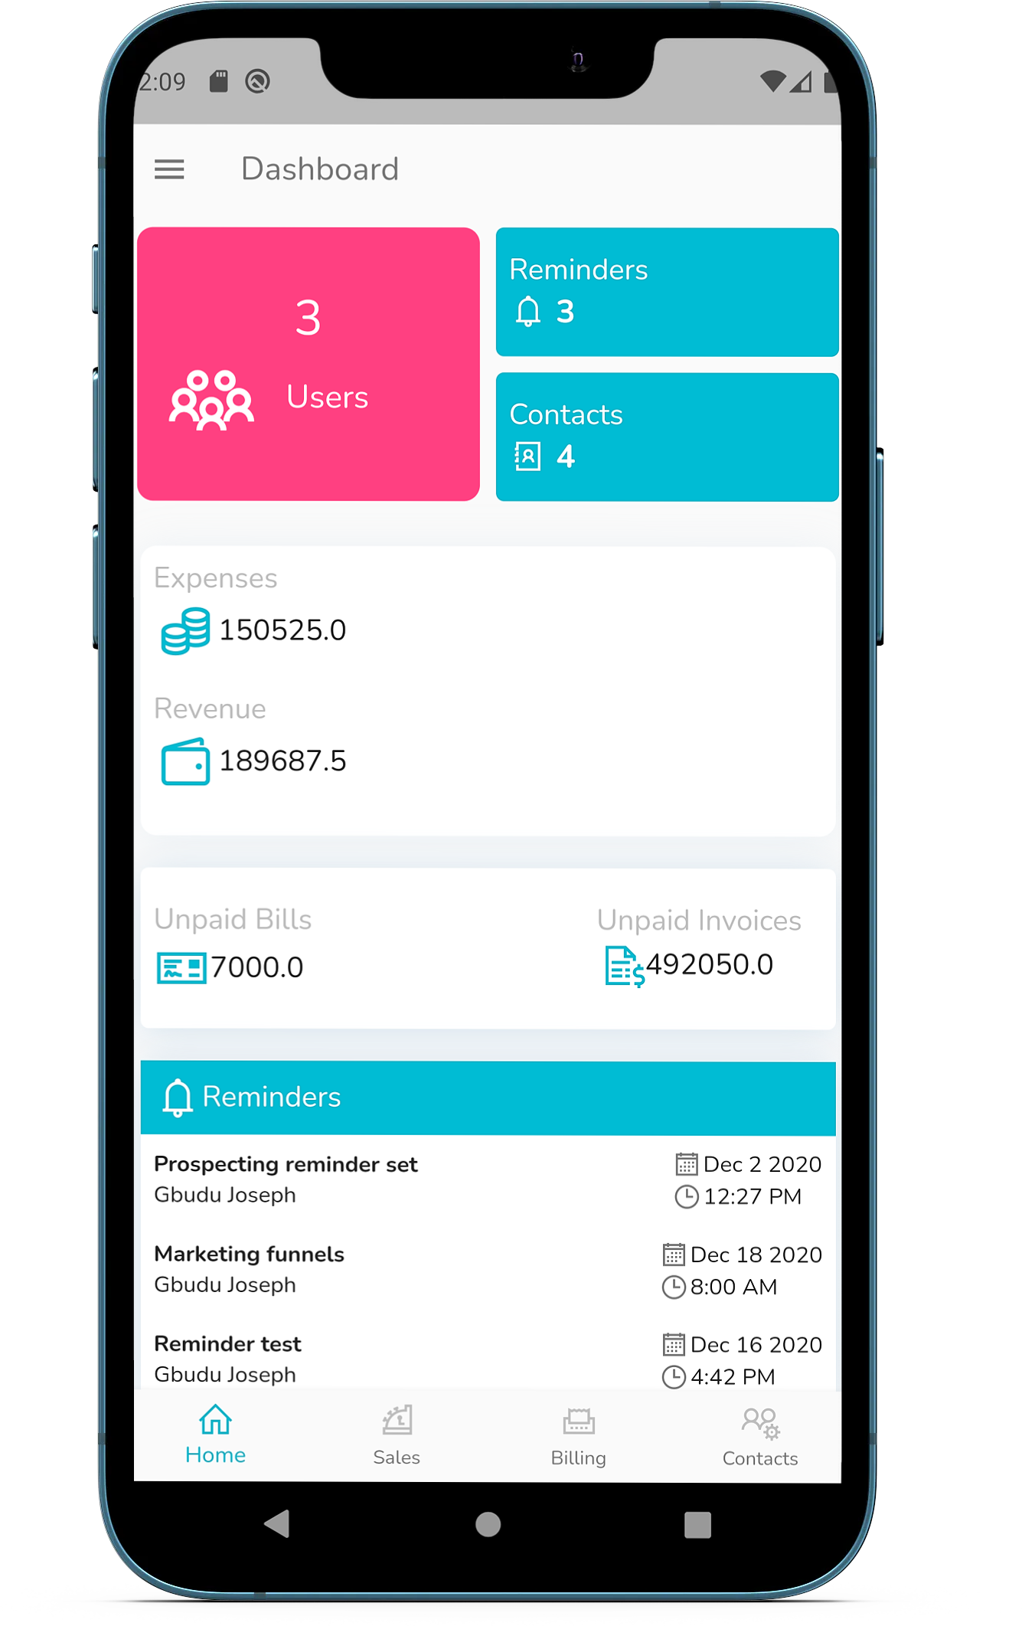
ALSO?
I am mobile enabled, I follow you everywhere you go. (ios, android etc)

Slide 7
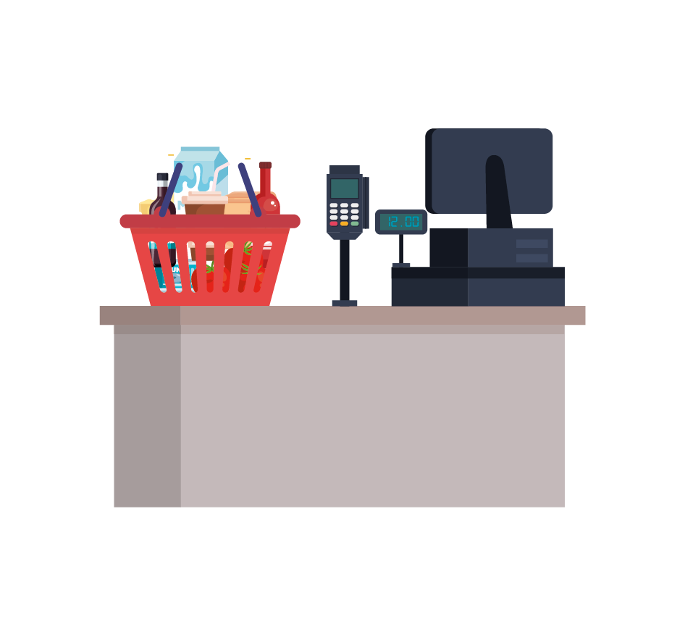
I HAVE A POS Version
A point of sale system, or POS, is the place where your customer makes a payment for products or services at your store.

Slide 8
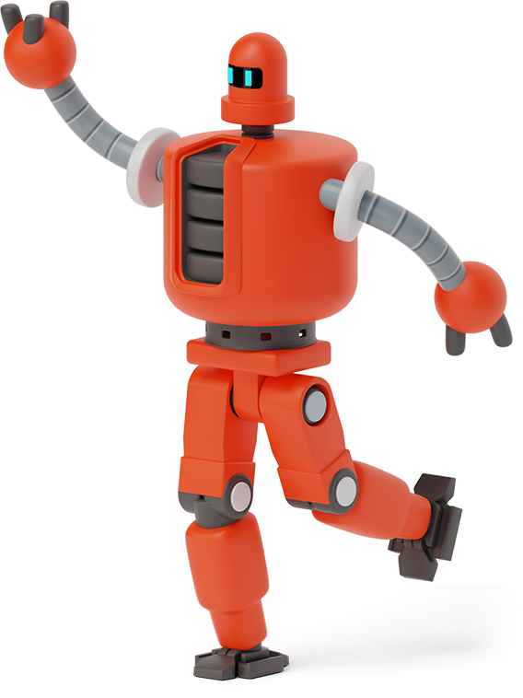
LETS SEE HOW I WORK

Slide 9
Thanks!
Any questions? You can find me at:
www.cnxretail.com

